Slide 1

JOB FLOW VISUALIZATION
Nitin Tewari

Slide 2
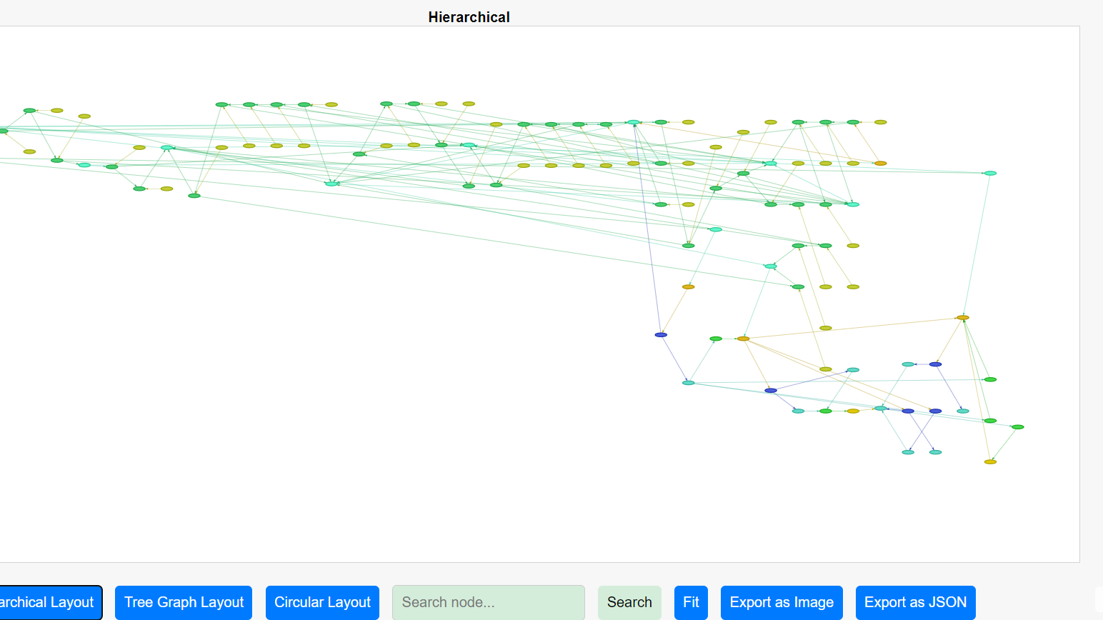
Overview
Job Flow Visualization is a powerful tool that enhances productivity. This presentation will explore various strategies and insights that can help by leveraging visualization techniques to optimize workflows and improve efficiency. Let’s delve into the transformative impact of visualizing job flows.

Slide 3
Benefits
Reduce analysis time
Easy visualization
Generates data

Slide 4
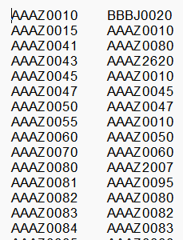
Input
The job scheduler extract needs to be ingested
as rows in format ‘Job’ & ‘Dependent Job’
Processing
Ingest data into the python module to generate HTML pages. Use JS, CSS, HTML to render the page.

Slide 5
Key Features
Analyse the job dependencies in Hierarchical, Tree Graph and Circular layout.
Zoom and scroll as required.
Hover mouse over each node to get the details of predecessor and successor dependencies.
Export the dependencies as JSON file for ingesting in another tool. Also take a screenshot of the graph at required levels.
Search the job name in the complex layout for closer look on the required job analysis.
Identify different jobs cluster.
Colour coding and high lighting the dependencies for better visualization.

Slide 6
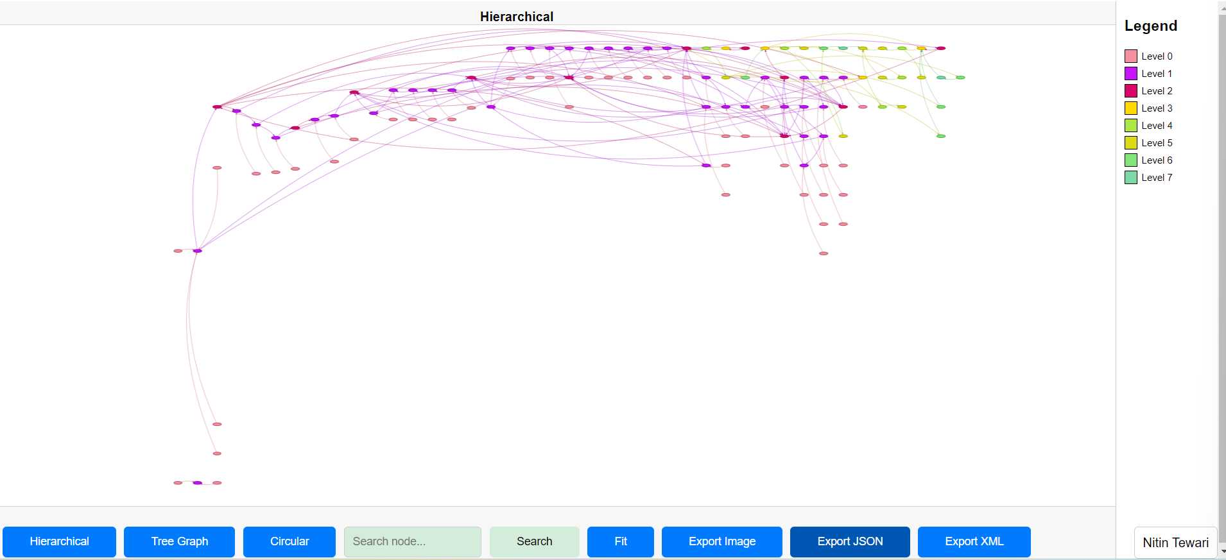
Key Layouts

Slide 7
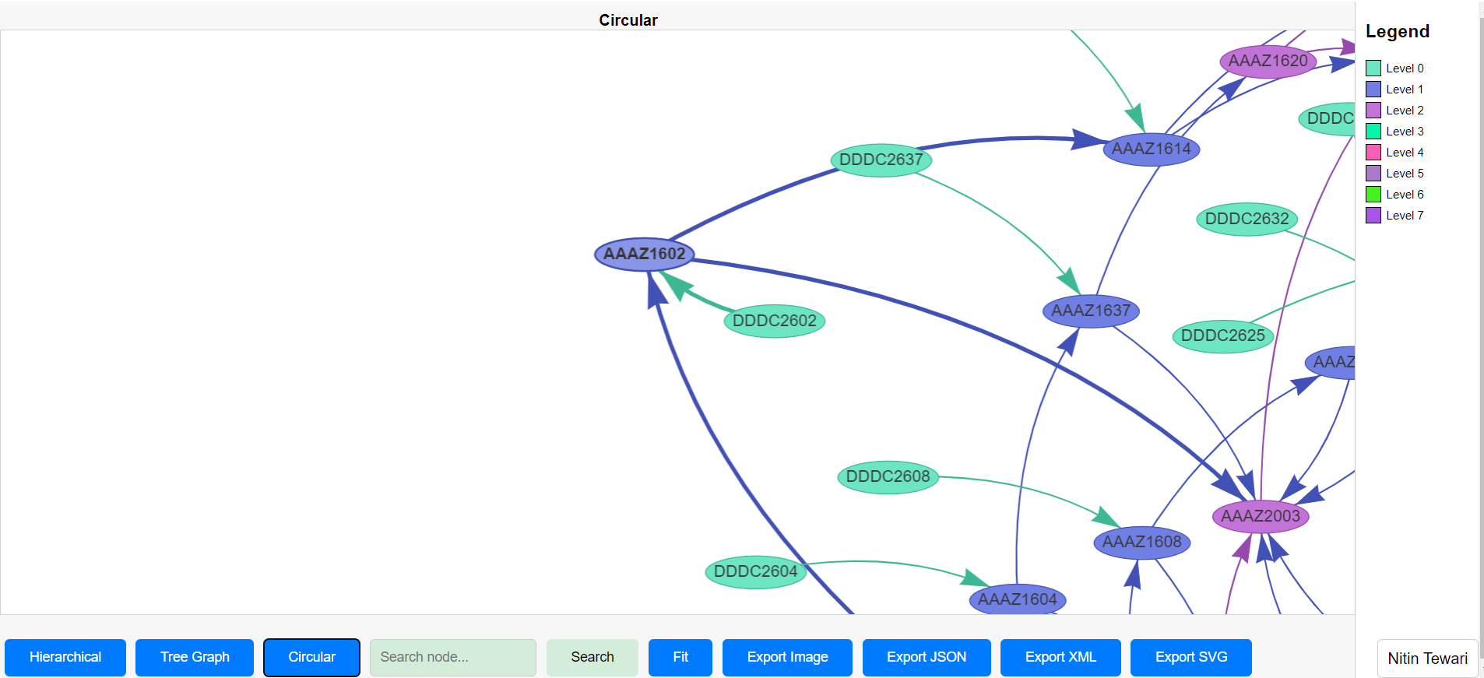
Key Layouts- Zoom/closer look

Slide 8
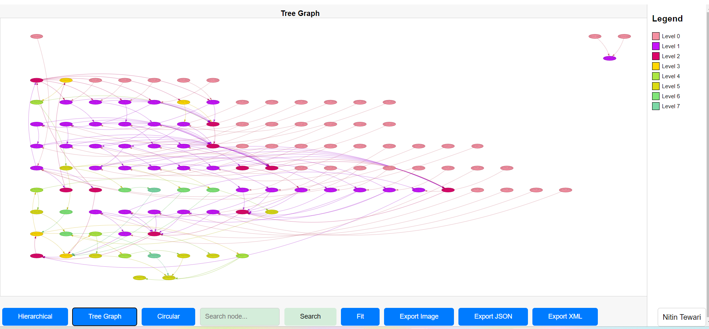
Key Layouts

Slide 9
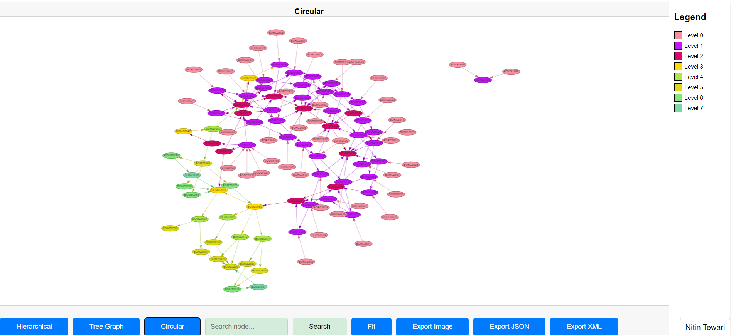
Key Layouts

Slide 10
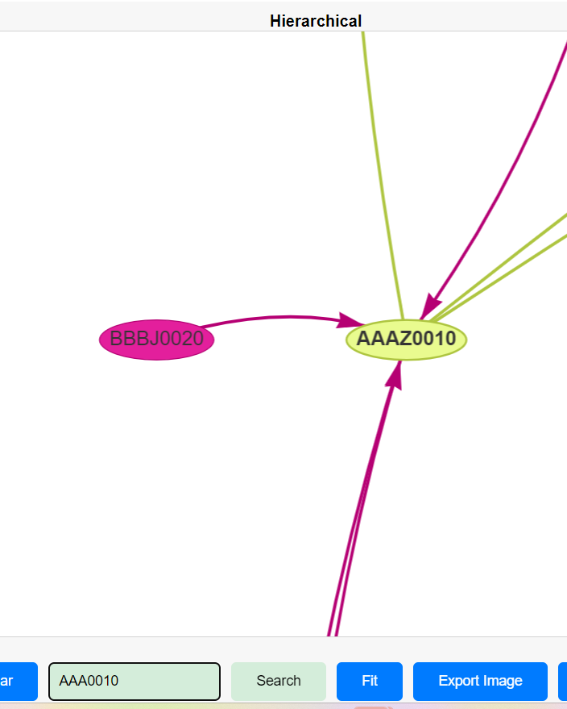
Search
Search the required job in the complex diagram.

Slide 11

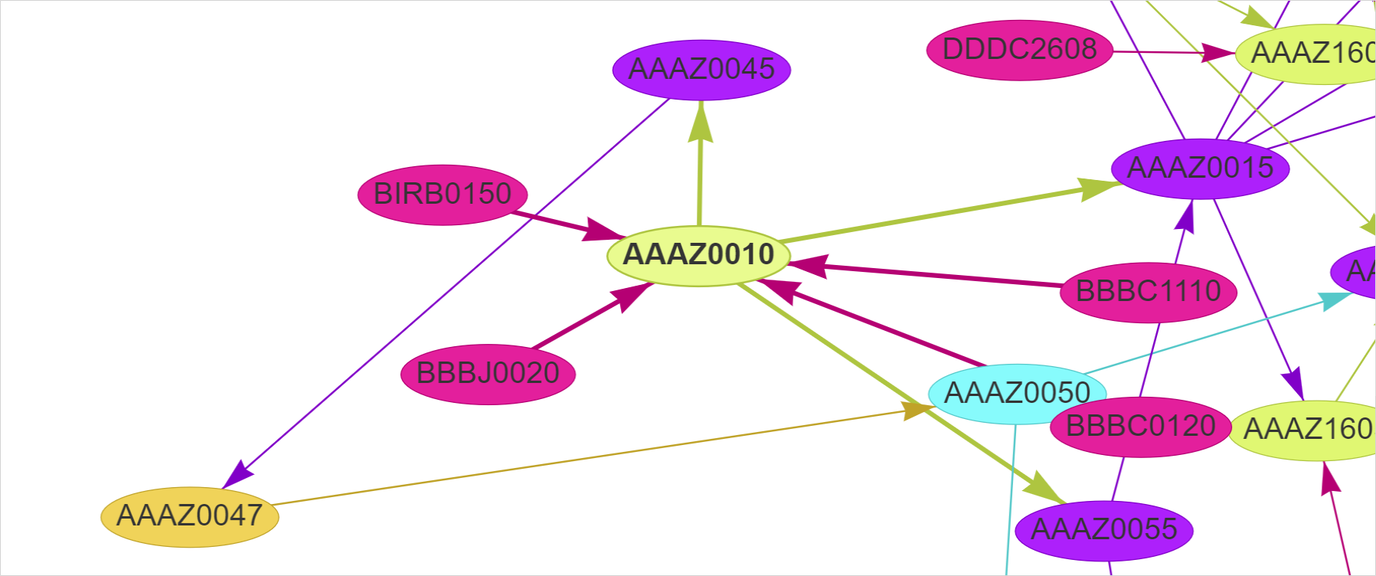
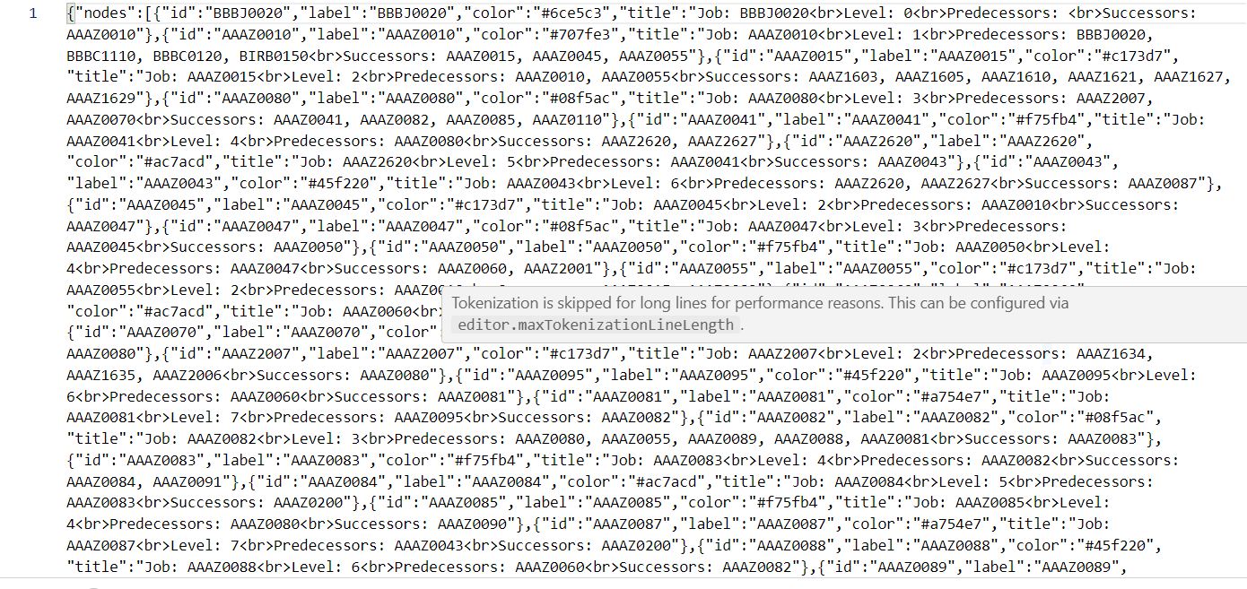
Export Dependencies: As Image, JSON & XML
Get the screenshot of the required job with dependencies.
Export job dependencies as JSON file for exporting to
other tools.
Image with no background

Slide 12
Conclusion and Key Takeaways
Implementing visualization techniques can lead to numerous benefits, including improved decision-making. In conclusion, enhancing productivity through job flow visualization is not just beneficial but essential in today’s fast paced work environment.

Slide 13
Thanks!
Do you have any questions?
Nitin Tewari

